Slide 1
Newton’s First Law

Slide 2
By the end of this lesson, you should be able to:
Recall Newton's First Law.
Determine if an unbalanced force has been applied to an object.
Explain the concept of inertia.

Slide 3
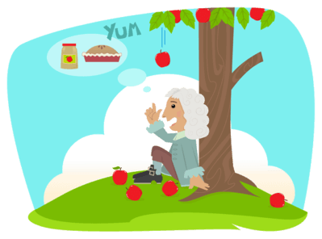
The three most important laws which you need to know about are Newton's Laws of Motion.
These three laws are important because they explain how forces change the motion of objects.

Slide 4
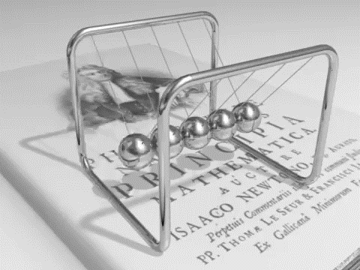
Newton's First Law:
An object will remain in a state of constant motion unless an unbalanced force acts on it.
"Constant motion" means that the object is not accelerating.

Slide 5

In other words, the first law states that an object will resist change in motion, unless a force is applied to change the motion.
This means that an object travelling at a constant velocity can only change its speed or direction if an unbalanced force acts on it.

Slide 6
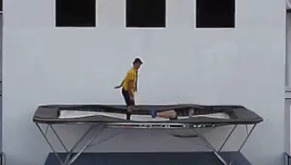
An object that is stationary is in constant motion - zero constant motion:
An object that is stationary (not moving) can only start moving if an unbalanced force acts on it.

Slide 7
Can you remember what the difference between balanced and unbalanced forces is?
The forces acting on an object are balanced if the net force is 0 N.
The forces are unbalanced if the net force is anything except 0 N.
You find the net force by adding up all the forces acting on the object. Remember, equal forces in opposite directions cancel to produce 0 net force.

Slide 8
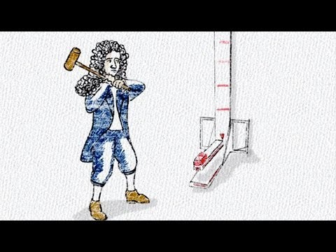

Slide 9

For the majority of the universe (the vacuum of space), the implications of the first law are much more obvious.
There are no unbalanced forces like air resistance in space, so if our soccer ball travels in constant motion, it will stay in constant motion!

Slide 10
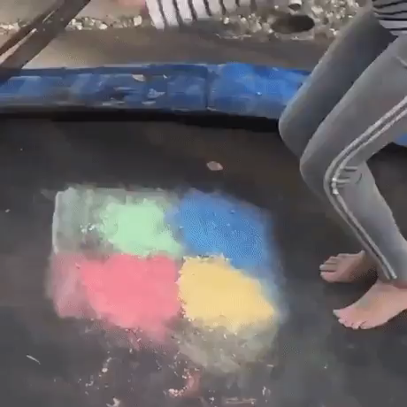
Newton's First Law arises due to a property called inertia.
Inertia is the tendency of an object to resist a change in its motion.

Slide 11

The inertia of an object means that it either wants to remain stationary or to continue travelling in a straight line at a constant speed.
We need to apply an unbalanced force to the object to overcome its inertia.
For example, in the gif below, the dog did not apply an unbalanced force to the baby, so the baby's inertia kept it in the same place.

Slide 12


Slide 13
The amount of inertia which an object has depends on its mass.
An object with larger mass has a greater inertia. This makes it harder to move.

Slide 14
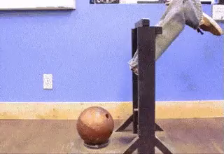
An object with a large inertia requires a larger force to make it move.
Think about trying to kick a bowling ball versus kicking a balloon.
The bowling ball has a larger mass, giving it a larger inertia, so you need to apply a larger force to move it along the ground. The balloon has a very light mass, and so is easily moved.

